Slide 1
Ambassadors meeting
Solucom at a glance
2014/15 full-year results and Solucom 2020 strategic plan Investors' meeting - 3 June 2015

Slide 2
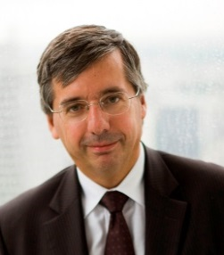
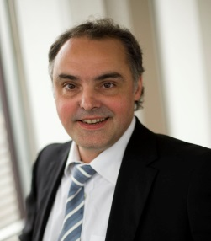
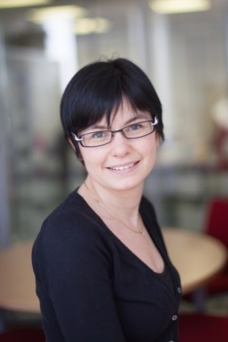
Governance
Pascal IMBERT
Chairman of the Management Board
Patrick HIRIGOYEN
COO and Member of the Management Board
Tiphanie BORDIER
Chief Financial Officer

Slide 3
Solucom at a glance
25-year track record
1,500 employees
Listed on the Euronext index since 2000
Specialised in management and IT system consulting
Company clients rank among the top-200 major companies and local authorities operating in all industries
Company mission: to successfully carry out the corporate transformation projects of our clients
3
Notes:
3

Slide 4
Contents
►
1. 2014/15 full-year results
2. 2014/15 key events
3. New strategic plan: Up 2020
4. 2015/16 outlook

Slide 5
Strong 2014/15 growth: +15%
Growth of 15% in full-year revenues
of which +11% like-for-like⁽¹⁾
full-year growth objective easily surpassed
June 2014
growth target
Nov 2014 growth target
Reported
Revenues
> 8%
> 12%
+15%
(1) Excluding : Lumens Consultants (consolidated since 01/12/13)
Trend Consultants (consolidated since 01/01/2014)
The industrial division of PEA Consulting (consolidated since 01/10/2014)
Audisoft Oxéa (consolidated since 01/11/14)
Hudson & Yorke (consolidated since 01/03/15)
5

Slide 6
Solid operating indicators
At 31/03/2015
Occupation rate
Average daily rate
Backlog
Headcount
83%
stable on 2013/14 levels
up 0.7%
visibility still limited
up 14%
€718
3.3
months
1,514
End of year smoother than expected
Notes:
Message Atterrissage T3 à faire passer

Slide 7
Operating margin growth at top end of forecast range
Consolidated FY figures at 31/03 (€m)
cv
2014/15
2013/14
% change
163.1
141.6
+15%
Revenues
21.1
18.2
+16%
Operating income on ordinary activities
Ebit margin
12.9%
13.0%
Operating income
20.4
17.7
+15%
Group share of net income
12.6
10.9
+15%
Net margin
7.7%
7.7%
Notes:
7

Slide 8
Solid cash generation
Consolidated FY figures at 31/03 (€m)
cv
2014/15
2013/14
Gross cash flow margin
14.5
11.7
Change in WCR
0.0
(1.0)
Cash flow from operations
14.6
10.6
Net cash flow from investments
(6.9)
(5.2)
(6.5)
(5.9)
- of which acquisitions
(1.5)
(2.2)
(1.5)
Net cash flow from financing operations
- of which dividends
(1.6)
(1.6)
Change in cash and cash equivalent
6.1
1.9
Notes:
8

Slide 9
Net cash position enhanced after financing of acquisitions
Consolidated audited figures at 31/03/15 (€m)
Non-current assets
(of which goodwill: 48.0)
54.9
72.9
Shareholders' equity
Current assets
(excluding cash)
62.2
12.0
Long-term liabilities
(of which financial liabilities: 3.2)
Cash
26.2
58.4
Current liabilities
(of which financial liabilities: 0.4)
Assets
Liabilities
 Net cash €22.6m
vs. €16.6 at end-March 2014
Notes:
9

Slide 10
Allocation of share capital at 31/03/15
Treasury stock
1.3%
Number of shares
4,966,882 (no potential dilution)
Dividend to be propsed at the 22 July 2015 AGM
€0.39 per share (+18%)
Free Float
40.7%
Founding shareholders and company directors
52.8%
Employees
5.2%
Tech 40
Entreprise innovante
10
Notes:
10

Slide 11
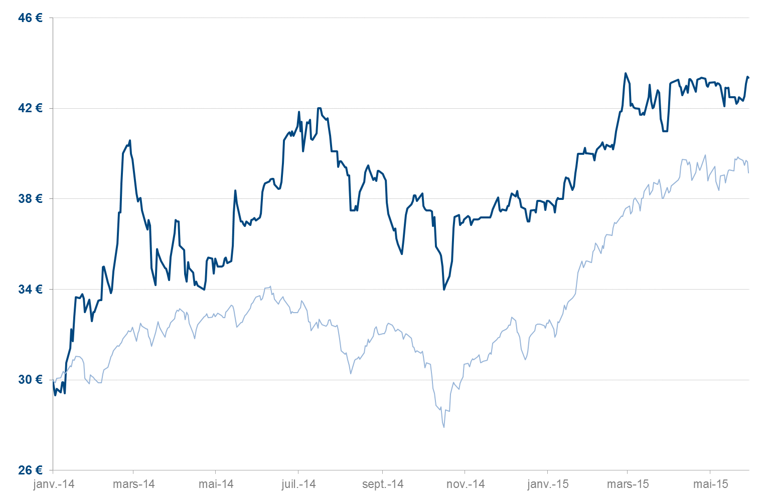
Trends in Solucom's share-price performance (since 1 January 2014)
Solucom data at 29/05/15
Share-price performance since 01/01/15
Average liquidity
(Average daily trading volumes on a 12-month sliding scale at 01/01/14 - Source: Euronext at 30/04/15)
+ 14%
€105,005
Solucom
€43.35
+ 45%
CAC MID & SMALL INDEX*
+31%
* CAC MID & SMALL adjusted to the Solucum 31 December 2013 share price.
Notes:
11

Slide 12
Contents
1. 2014/15 full-year results
►
2. 2014/15 key events
3. New strategic plan: Up 2020
4. 2015/16 outlook
Notes:
Convey simple messages

Slide 13
A successful year for Solucom in terms of Human Resources
Full-year recruitment-plan objectives fulfilled
more than 300 staff hirings
 Churn rate still low at 10% normal range: 12-15%
2015 awards
13
Notes:
Full-year recruitment-plan objectives fulfilled:
sourcing percentage of hirings from commercial colleges and engineering schools (little change on year-earlier levels) - increase in number of hirings recruited via internet and social networks, vs.......(no info from HR) - hiring trends rom schools: group 1-2 / vs. 3-4 (little change on year-earlier levels) - competition keener with strong comeback of auditing firms and the appeal of players in the digital sector (start-ups…)
351 staff hirings - 38 at end of PE = source: HR statistics
Churn rates of our direct competitors and the "big four": no details but it would seem that these average around 20%

Slide 14
Growth momentum driven by all our client accounts
Top 20 clients 2014/15
11%
ENGIE
11%
EDF
8%
LA POSTE
Local authorities
6%
Telcos
CREDIT AGRICOLE
SNCF
5%
6%
1%
TOTAL
Banking - Insurance
6%
BANQUE DE FRANCE
4%
3%
30%
BNP PARIBAS
3%
THALES
Industry- Energy Utilities
3%
AIR LIQUIDE
2%
Services - Transport Distribution
SOCIETE GENERALE
41%
2%
CARREFOUR
23%
2%
ALLIANZ
2%
AXA
BPCE
2014/15 industry revenue breakdown
2%
CAISSE DES DEPOTS
1%
SAINT GOBAIN
1%
1%
MALAKOFF MEDERIC
1%
POLE EMPLOI
1%
LAFARGE
Client account – tending upwards
Client account – tending downwards

Slide 15
Audisoft-Oxea & Hapsis: two acquisitions in France…
Management consulting,firm specialised in banking sector 31 March 2015 revenues: €4.5m
Risk-management and cyber-security consulting 31 March 2015 revenues: €4.3m
Acquisition features
100%-capital acquisition
financed exclusively in cash
consolidated since 1 November 2014
business assets acquisition
financed exclusively in cash
consolidated since 1 April 2015
… plus acquisition of the industrial activities of PEA Consulting

Slide 16
…and a first acquisition in the UK
Large-scale sourcing operations
Strategic consulting in the field of information and communication technologies (ICT) 31 March 2015 revenues: £3.7m
Major clients:
Barclays, BP, UBS, Zurich,
Department of Energy & Climate Change
Acquisition features
100%-capital acquisition
financed exclusively in cash
consolidated since 1 March 2015

Slide 17
Solucom’s strategic plan « Solucom 2015 » is a success
35% of revenues
Solid footholds in new sectors of activity
Solid position secured in management
consulting
International expansion strategy launched
Change in size achieved over the period
Morocco
Singapore
UK
~ 60% growth
8 acquisitions in 4 years
2nd ranking independent consulting firm in France in 2014…
…and possibly number 1 in 2015 !

Slide 18
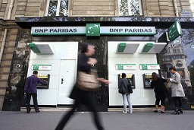
Solucom 2015: strategy to extract value by combining Business & Technology knowledge now in place
FACTEO – La Poste
‘Reinventing the postman profession at the digital era’
SMART ELECTRIC LYON - EDF
‘Large-scale testing of future energy services’
DIGITAL WORKING – BNP Paribas
‘Spread a digital culture within all the company teams’

Slide 19
Strategic strengths we can leverage for the future
Capacity to win market share
Ability to extract value by combining Business and Technology knowledge
Quality and strength of our teams
Savoir-faire in the field of external growth
Financial capacity

Slide 20
Contents
1. 2014/15 full-year results
2. 2014/15 key events
►
3. New strategic plan: Up 2020
4. 2015/16 outlook

Slide 21
2015 – 2020, the 3rd revolution now under way
The dawning of a new age, after a period of unprecedented recession
The transformations taking place are creating a new and for the
most part unknown environment
Our clients must adapt to these changes and transform ... or else fall
into decline and disappear
 Everything to be determined in the next few years

Slide 22
2015 - 2020, a first-rate opportunity for Solucom…
Natural legitimacy on the digital sector
Track record in operating the transformations
that prompted the ongoing revolution
Positions secured in the most highly-exposed
sectors

Slide 23
...but also a tremendous challenge
Transformations of an unprecedented dimension for our clients … …requiring stronger market presence
Global transformations… …requiring international status
Our clients' structural choices…
…requiring, more than ever, vision, relevance, and value

Slide 24
“Up 2020”: our new strategic plan
Growth
International presence
Value creation

Slide 25
Leverage our strengths
Ability to win market share
Business + Technology
Collective mindset
External growth
Financial capacity

Slide 26
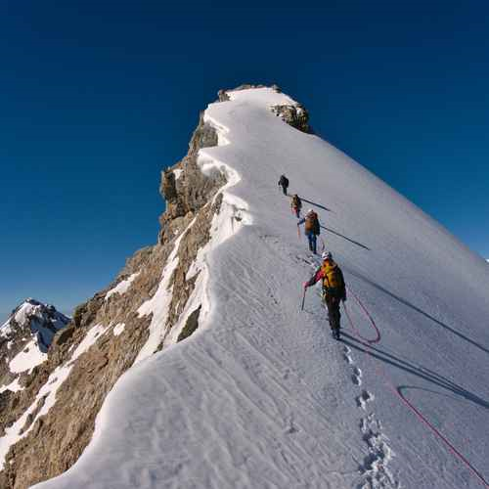
Bringing together more of the “best-talent”
1
Attract as many highly-profile consultants within the context of a resurgence of the "talent war"
Anticipate changing trends in employee expectations so as to remain a lasting employer of choice
Acquire and efficiently integrate the new skills required

Slide 27
Step up our international expansion
2
UK
Singapore
Hong-Kong
Brazil
Build up 2 to 3 major positions abroad in regions with strong growth potential
Capitalise on local-development opportunities
Launch an intensive strategy to expand the Group’s international footprint
Dubai
Morocco
Belgium
…
Notes:
Dans le commentaire, bien préciser le 3ème point « en bosse et en creux »

Slide 28
Create more value
3
Broaden our vision so that we can advise our clients in making their most structural choices
Guarantee a quality performance in carrying out missions
Install innovation at the heart of our activities
Notes:
Complément sur le premier item (mais c’est peut être plus un commentaire)

Slide 29
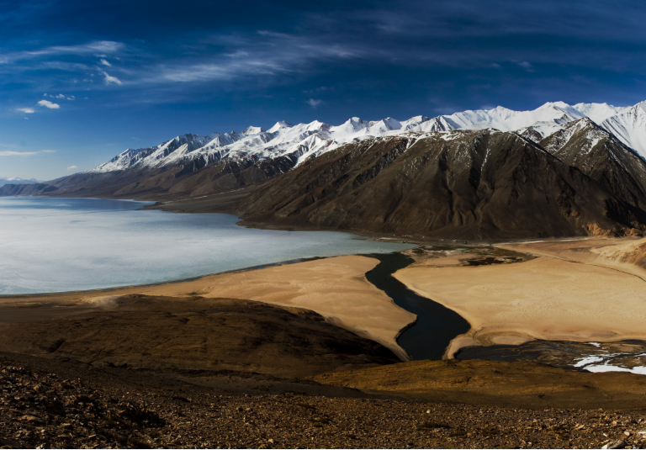
Enhance our operating performance ...and design a new Solucom
Because our business model needs a new lease of life
Because digitisation is a challenge for us as well
Because our ability to extract value is key to our future performance
A more horizontal, more agile company

A more innovative company

A company where value extraction is the key priority for our top talents

Notes:
Dans le commentaire aller vite sur cette page pour ne pas être en redondance avec la page suivante

Slide 30
"Up 2020 " strategic plan: 3 challenges, 3 objectives
Growth
€300m revenue
International presence
20% of sales generated internationally
Value creation
15% EBIT margin

Slide 31
Agenda
1. 2014/15 full-year results
2. 2014/15 key events
3. New strategic plan: Up 2020
►
4. 2015/16 outlook

Slide 32
Signs of improvement in 2015
2015 showing signs of improvement...
more projects seeing the light of day
…sustained by growing momentum of trends in favour of corporate digitisation…
Digital working – Digital-customer relations – Smart – Big data
…and transformations caused by digitisation
However, limited visibility and strict pricing control
Notes:
Decision-making easier, visibility improved
Comments: M&A and organisation -bimodal ISD (short and long cycle)

Slide 33
2015/16 full-year objectives
Growth revenues
EBIT margin 11-13%
> 12%
(excluding new acquisitions)
(excluding new acquisitions)
34

Slide 34
Financial calendar
Q1 2015/16 revenues 21 July 2015
(followed by investors' meeting held after market close)
H1 2015/16 revenues 21 October 2015
(followed by investors' meeting held after market close)
2015/16 interim results 24 November 2015
(followed by investors' meeting held the next day after market close)
Notes:
34

Slide 35
www.solucom.fr
Contacts:
Solucom
Pascal IMBERT
Chairman of the Management Board
01 49 03 20 00
Investors relations
Mathieu OMNES
Investor/financial analyst relations
01 53 67 36 92

